Slide 1
Practice Patterns and the Role of Testosterone In Prostate Cancer
Evan Goldfischer, MD
Director of Research
Premier Medical Group of the Hudson Valley
Poughkeepsie, New York

Slide 2
AbbVie Disclosures
This scientific symposium is being conducted on behalf of AbbVie US Medical Affairs. AbbVie US Medical Affairs is the sole sponsor of this scientific symposium and reviewed and approved all content presented
AbbVie US Medical Affairs selected today's presenter and is compensating him for today’s presentation. This symposium is intended for health care professionals practicing within the United States and Puerto Rico only, and it is not medical advice for the care and treatment of any actual patient who may be under your care
Requests for off-label or investigational use of a product may be referred to AbbVie Global Medical Information at 1-800-633-9110 or www.abbviemedinfo.com
2

Slide 3
Financial Disclosure
In the past 12 months, I have had the following financial relationship with the manufacturer:
AbbVie consultant
Speaker’s bureau and teaching engagements
Advisory committee/Board
I do not intend to discuss an unapproved or investigative commercial product in my presentation

Slide 4
Objectives
Review the importance of monitoring testosterone in patients with prostate cancer (PCa) who are on androgen deprivation therapy (ADT)
Impact of testosterone escape
Understand the relationship between testosterone and prostate specific antigen (PSA) as it relates to disease progression and overall outcomes

Slide 5
In the US, PCa Is the Second Leading Cancer in Men¹
PCa Statistics (2019)²
Estimated new cases | 174,650 (9.9% of all new cancers)
Estimated deaths | 31,620 (5.2% of all cancer deaths)
5-year survival | 98%
Median age at diagnosis | 66
Median age at death | 80
Today, about 50% of American men with low-risk disease opt for active surveillance instead of therapy³
As of 2013, 4% of all PCa patients are estimated to have CRPC⁴
CRPC, castration-resistant prostate cancer; PCa, prostate cancer; US, United States.
References: 1. National Cancer Institute. Cancer Stat Facts: Common Cancer Sites. https://seer.cancer.gov/statfacts/html/common.html. Accessed April 22, 2019. 2. National Cancer Institute. Cancer Stat Facts: Prostate Cancer. https://seer.cancer.gov/statfacts/html/prost.html. Accessed April 22, 2019. 3. Cavallo J. ASCO Post. July 15, 2018. http://www.ascopost.com/issues/july-25-2018/when-can-patients-with-gleason-6-prostate-cancer-safely-undergo-active-surveillance. Accessed March 21, 2019. 4. Liede A et al. J Clin Oncol. 2017;31(15 suppl):e16052.

Slide 6
The Role of Testosterone in PCa
Medical or surgical strategies to minimize testosterone production are the most common approaches in the management of recurrent or advanced disease¹
The relationship of testosterone levels to prostate cancer outcomes has been proposed in some studies and warrants further investigation²⁻⁴
Testosterone escape is defined as an increase in serum testosterone after castration levels have been achieved with GnRH agonists²
GnRH agonists FDA-approved for advanced prostate cancer recommend periodic testing to ensure castrate testosterone levels are maintained during treatment⁵
FDA, Food and Drug Administration; GnRH, gonadotropin-releasing hormone.
References: 1. Novara G et al. Urol Int. 2009;82(3):246-255. 2. Morote J et al. J Urol. 2007;178:1290-1295. 3. Perachino M et al. BJU Int. 2010;105(5):648-651. 4. Dason S et al. Can Urol Assoc J. 2013;7(5-6):e263-e267. 5. Lupron DEPOT-PED [package insert]. North Chicago, IL: AbbVie; 2014.

Slide 7
Testosterone: Defining Castration Levels
The US FDA defines medical castration as testosterone levels below 50 ng/dL (ie, 1.735 nmol/L)¹
The Bethesda Guidelines recommend a threshold for serum testosterone after ADT to be 20 ng/dL (ie, 0.694 nmol/L)²
Clinical studies have shown testosterone levels to be 20 ng/dL (ie, 0.694 nmol/L) or lower following surgery^{1,3,4}
Median testosterone level post-orchiectomy was 15 ng/dL (0.5 nmol/L; 95% CI 12-17 ng/dL)⁵
Median testosterone level 12 months post-orchiectomy was 16 ng/dL (95% CI 10-22 ng/dL)⁶
However, the clinical benefits of maintaining testosterone levels <20 ng/dL versus <50 ng/dL have not been prospectively studied
ADT, androgen deprivation therapy; CI, confidence interval.
References: 1. Oefelein MG et al. J Urol. 2000;164:726-729. 2. Djavan B et al. BJU Int. 2011;110:344-352. 3. Lin B et al. Urology. 1994;43:834-837. 4. Vogelzang NJ et al. Urology. 1995;46:220-226. 5. Oefelein MG et al. Urology. 2000;56(6):1021-1024. 6. Røhl HF, Beuke HP. Scand J Urol Nephrol. 1992;26(1):11-14.

Slide 8
Testosterone Escape
In 1966, Charles B. Huggins won the Nobel Prize in Physiology or Medicine¹
He was the first to report that PCa is androgen dependent²
Testosterone suppression has been the mainstay of the treatment of locally advanced and recurrent PCa³
An estimated 6%-13% of patients’ serum testosterone levels can go above 50 ng/dL (1.74 nmol/L), resulting in what is commonly known as testosterone escape³
Patients who did not achieve nadir testosterone <0.7 nmol/L had a significantly higher risk of developing CRPC^{4,a}
Additionally, testosterone levels should remain suppressed to levels below 32 ng/dL (1.1 nmol/L) in order to maximize survival³
ª0.7 to 1.7 nmol/L: HR, 1.62; 95% CI, 1.20 to 2.18; ≥1.7 nmol/L: HR, 1.90; 95% CI, 0.778 to 4.70.
References: 1. The Nobel Prize. Charles B Huggins Facts. https://www.nobelprize.org/prizes/medicine/1966/huggins/facts. Accessed March 26, 2019. 2. Røhl HF, Beuke HP. Scand J Urol Nephrol. 1992;26(1):11-14. 3. Wilke D et al. Pharmacotherapy. 2018;38(3):327-333. 4. Klotz L et al. J Clin Oncol. 2015;33(10):1151-1156.

Slide 9
Retrospective Review

Slide 10
Morote et al: Research Objectives
Objectives
Primary objective: Determine the lowest serum testosterone level with a clinically relevant impact on time to androgen independent progression (AIP)
Secondary objective: Evaluate the effect of continuing bicalutamide with GnRH agonists on castration escapes
AIP, androgen independent progression.
Reference: Morote J et al. J Urol. 2007;178:1290-1295.

Slide 11
Defining Castration-Resistant Prostate Cancer (CRPC)/Androgen Independent Progression (AIP)
CRPC is defined as 3 consecutive PSA increases after nadir
When the first increase in PSA was detected, 2 more PSA determinations were performed in the following 2 months
Survival free CRPC was established as the period between the day of the first LHRH agonist injection and the day of the first PSA increase after the nadir PSA
LHRH, luteinizing hormone-releasing hormones; PSA, prostate specific antigen.
Reference: Morote J et al. J Urol. 2007;178:1290-1295.

Slide 12
Morote et al: Potential Clinical Consequences of Testosterone Escape
A
S
S
E S S M
E
N
T
(n=28)
GnRH agonist Q3 months + Antiandrogen QD
Lead-in
(N=73)
Median follow-up 54.1 months
(range 12-240 months)
Antiandrogen QD
x 2 weeks
(n=45)
GnRH agonist Q3 months
PSA + testosterone measured Q6 months^{a,b}
A hormonal escape was defined as an increase in serum testosterone after castration levels were achieved.
ªSamples collected 8 to 12 weeks following GnRH agonist administration (between 8 am and 10 am).
^{b}Testosterone levels determined using a chemiluminescent assay (lower detection limit <15 ng/dL).
QD, every day; Q3, every three months; Q6, every six months.
Reference: Morote J et al. J Urol. 2007;178:1290-1295.

Slide 13
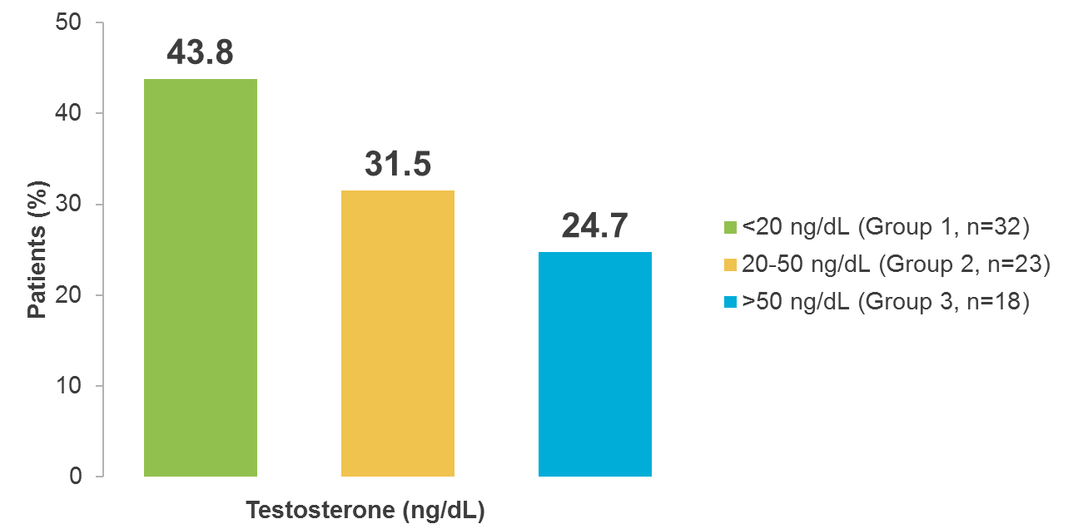
Morote et al: Testosterone Analysis of 3 Consecutive Measurements at 6-Month Intervals
N=73
Patients (%)
Testosterone Groups (ng/dL)
Reference: Morote J et al. J Urol. 2007;178:1290-1295.

Slide 14
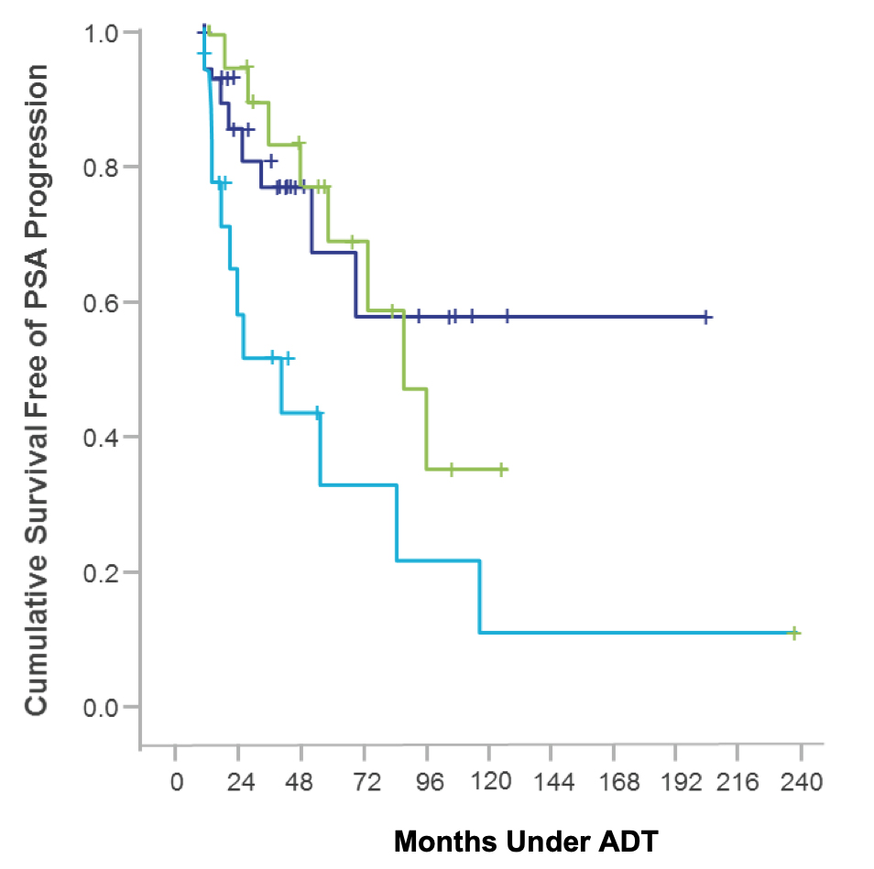
Morote et al: Fewer Escapes and Lower Testosterone Reduce Incidence of CRPC
P=0.0207
N=73
Mean survival=106 months
Group 1 (<20 ng/dL, ie, <0.694 nmol/L)
Mean survival=90 months
Group 2 (20-50 ng/dL)
Mean survival=72 months
Group 3 (>50 ng/dL, ie, >1.735 nmol/L)
Months Under ADT
Reference: Morote J et al. J Urol. 2007;178:1290-1295.

Slide 15
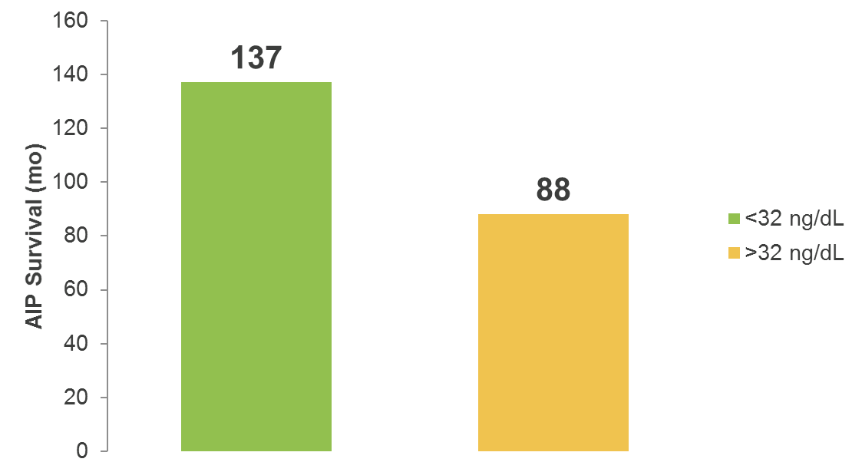
Morote et al: Testosterone Levels Inform CRPC/AIP
P=0.03
N=73
Mean AIP Survival (mo)
Testosterone Groups (ng/dL)
mo, months.
Reference: Morote J et al. J Urol. 2007;178:1290-1295.

Slide 16
Morote et al: Conclusions
Monitoring testosterone is an important part of clinical practice when evaluating effects of hormonal therapy
There is a need to routinely evaluate testosterone level when initiating and following ADT
To obtain maximal androgen blockade, following a patient’s testosterone levels would allow redosing the LHRH agonists accordingly
Reference: Morote J et al. J Urol. 2007;178:1290-1295.

Slide 17
Dason et al: Prospective Cohort Study Objectives
Determine if testosterone levels below the accepted castration threshold (50 ng/dL) have an impact on time to progression to CRPC
A total of 32 patients undergoing ADT with LHRH agonist or antagonist were followed for a mean of 26 months. After initiation of ADT, PSA and testosterone were measured every 3 months for the duration of the study. Patients with any testosterone >50 ng/dL were excluded
Reference: Dason S et al. Can Urol Assoc J. 2013;7(5-6):e263-e267.

Slide 18
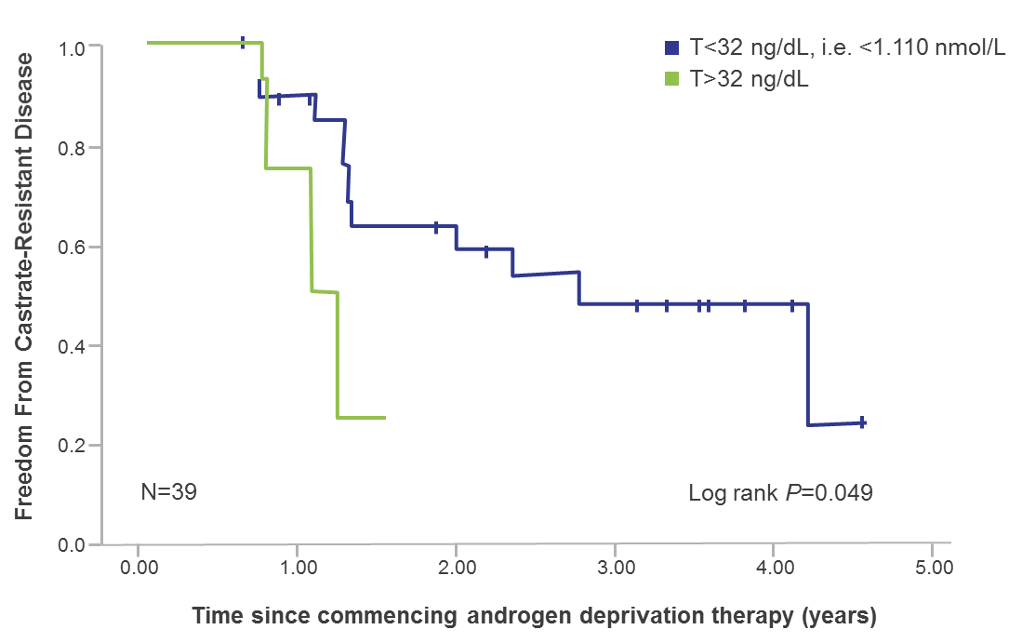
Dason et al: Lower Testosterone and ADT Outcome
Time to CRPCª Based on Mean T Levels Through 12 Months
T<32 ng/dL, ie, <1.110 nmol/L
T32-50 ng/dL
N=32
ªPatients were considered to have progressed to CRPC when there were at least 2 consecutive rises in PSA above nadir, clinical progression, or death from disease.
T, testosterone.
Reference: Adapted from Dason S et al. Can Urol Assoc J. 2013;7(5-6):e263-e267.

Slide 19
Dason et al: Conclusions
Adequate testosterone suppression (ie, lower threshold for castration) during ADT may play a clinically significant role in delaying CRPC
Testosterone level in the first year following initiation of ADT may serve as an early predictor of disease progression
9-month absolute testosterone <32 ng/dL (ie, 1.110 nmol/L) compared to >32 ng/dL had an increased time to CRPC (P=0.001)
1-year mean testosterone <32 ng/dL compared to 32-50 ng/dL had a significantly increased time to CRPC (P=0.05)
Large prospective studies are needed to better understand the optimum testosterone threshold during ADT treatment
Reference: Dason S et al. Can Urol Assoc J. 2013;7(5-6):e263-e267.

Slide 20
Perachino et al: Retrospective Study Objectives
Determine if the testosterone level achieved with ADT is directly related to survival and risk of death in men with metastatic prostate cancer, as agonistic analogues of LHRH are indicated for palliative treatment of these patients
Reference: Perachino M et al. BJU Int. 2010;105(5):648-651.

Slide 21
Perachino et al: Patient Characteristics (n=129)
Variable | Mean (SD), median (IQR) (range)
Age, years | 74.6 (6.7), 75 (52-88) (70-80)
Testosterone, ng/dL Baseline 6-months Nadir Months to nadir | 440 (200), 410 (67-1160) (305-539) 40 (40), 29 (4-280) (17.5-50.5) 185.8 (344.1), 54.0 (3.7-1879) (24.25-150.7) 17.1 (126.4), 0.22 (0.02-1425) (0.08-2.91)
PSA, ng/mL Baseline 6-months Nadir Months to nadir | 21 (15), 9 (1-79) (10-28) 13.9 (17.7), 16 (3-96) (3-14) 2.7 (8.6), 0.1 (0.01-72.8) (0.06-0.88) 9.5 (7.7), 6 (1-45) (6-12)
Follow-up, months | 47.5 (29.7), 40 (6-120) (22-72)
IQR, interquartile range; SD, standard deviation.
Reference: Perachino M et al. BJU Int. 2010;105(5):648-651.

Slide 22
Perachino et al: Correlation Between the Risk of Death and Testosterone During ADT
Gleason score distribution of 129 patients
Hazard ratios and related 95% Cl
Gleason score | n (%)
4-6 | 38 (29.5)
7 | 43 (33.3)
8-9 | 48 (37.2)
Total | 129 (100)
6m testosterone (mean 40 ng/dL)
6m PSA (mean 13.9 ng/dL) P<0.01
Age (mean 74.6 years)
m, months; CI, confidence interval..
Reference: Perachino M et al. BJU Int. 2010;105(5):648-651.

Slide 23
Perachino et al: Correlation Between the Risk of Death and Testosterone During ADT (continued)
Predictors of survival probability according to the Cox regression model
Variable | Coefficient (SEM) | Coefficient/SEM | Hazard ratio (95% Cl) | P
Age, years | 0.0359 (0.0200) | 1.795 | 1.037 (0.996-1.078) | 0.08
Gleason score | 0.3301 (0.1002) | 3.295 | 1.391 (1.141-1.696) | <0.01
Ln (6-month PSA level) | 0.2690 (0.0492) | 5.468 | 1.309 (1.187-1.443) | <0.01
(6-month testosterone) | 0.2874 (0.1190) | 2.415 | 1.333 (1.053-1.687) | <0.05
Ln, lymphadenopathy; SEM, standard error mean.
Reference: Perachino M et al. BJU Int. 2010;105(5):648-651.

Slide 24
Perachino et al: Conclusions
Mean testosterone (40 ng/dL) at 6 months was shown to have value in predicting survival (P<0.50)
Reference: Perachino M et al. BJU Int. 2010;105(5):648-651.

Slide 25
Klotz et al: Secondary Analysis Objectives
Determine if, in patients undergoing continuous androgen deprivation (CAD) therapy, a higher nadir testosterone value in the first year of ADT correlates with a reduced time to development of CRPC and lower CSS
Patients (n=626) randomly assigned to CAD were included in this analysis. Testosterone was measured every 2 months in the first year
CSS, cause specific survival.
Reference: Klotz L et al. J Clin Oncol. 2015;33(10):1151-1156.

Slide 26
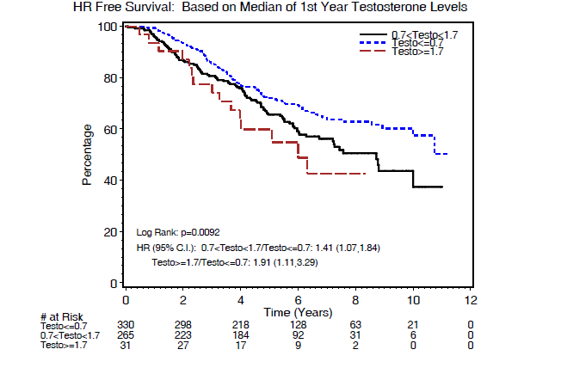
Klotz et al: Nadir Testosterone on ADT Predicts Time to CRPC Secondary Analysis of the SWOG PR-7 Intermittent vs Continuous ADT Trial
20<T<50 ng/dL
T ≤20 ng/dL
T ≥50 ng/dL
CRPC Percentage
20 < Testo < 50/Testo ≤ 20 ng/dL; 1.41(1.07, 1.84)
Testo ≥ 50/Testo ≤ 20 ng/dL; 1.91 (1.11, 3.29)
# at Risk
Testo ≤20 ng/dL
20 < Testo < 50 ng/dL
Testo ≥50 ng/dL
HR, hazard ratio.
Reference: Klotz L et al. J Clin Oncol. 2015;33(10):1151-1156.

Slide 27
Klotz et al: Conclusions
Patients with median testosterone >20 ng/dL had a significantly higher risk of developing CRPC (HR 1.41 for serum T 20-50 ng/dL [95% CI 1.07-1.84] and HR 1.91 for T >50 ng/dL [95% CI 1.11-3.29])
Patients with nadir (minimum) testosterone >0.7 nmol/L had a significantly higher risk of dying as a result of disease (0.7 to 1.7 nmol/L: HR, 2.08; 95% CI, 1.28 to 3.38; ≥1.7 nmol/L: HR, 2.93; 95% CI, 0.70 to 12.30)
Serum testosterone should be assayed regularly in such patients, and ADT modified to ensure levels <20 ng/dL are achieved
Reference: Klotz L et al. J Clin Oncol. 2015;33(10):1151-1156.

Slide 28
Wilke et al: Objectives of Database Review
To characterize the probability of testosterone escape during a course of radiotherapy and ADT in patients with PCa
Examine predictors of testosterone escape
PSA levels during testosterone escape
The impact of testosterone escape on outcomes
A retrospective chart review of 361 patients with nonmetastatic prostate cancer who were treated with ADT and RT were followed for a median of 4.7 years. Patients had a median of 6 testosterone measurements
Reference: Wilke D et al. Pharmacotherapy. 2018;38(3):327-333.

Slide 29
Wilke et al: Distribution of Testosterone
Younger age was a predictor for patients having higher maximum testosterone values during their course of ADT
ªAnalysis of variance test, on maximum testosterone comparison.
Reference: Wilke D et al. Pharmacotherapy. 2018;38(3):327-333.

Slide 30
Wilke et al: Distribution of PSA Values at Time of Testosterone Escape
PSA at the time of testosterone escape (>1.75 nmol/L; 69 testosterone escapes in 50 patients) was relatively low
Reference: Wilke D et al. Pharmacotherapy. 2018;38(3):327-333.

Slide 31
Wilke et al: Number of Maximum Testosterone Level Within Each Category by Course of LHRH Agonists
In patients with six or fewer testosterone measurements (n=174)
In patients with <6 testosterone measurements, the probability of testosterone escape was 0%–9% across LHRHa treatments, whereas in patients with >6 measurements the probability of testosterone escape was in the range of 10%–26%.
In patients with more than six testosterone measurements (n=187)
Comparison within and across tables were not statistically significant.
IM, intramuscular; LHRHa, luteinizing hormone-releasing hormone agonist; SC, subcutaneous.
Reference: Wilke D et al. Pharmacotherapy. 2018;38(3):327-333.

Slide 32
Wilke et al: Retrospective Review Conclusions
In this cohort of patients, an undetectable PSA does not rule out the presence of higher than desired levels of testosterone, reinforcing the need to monitor testosterone levels, especially in younger patients
There appears to be no impact of testosterone escape on either biochemical relapse-free survival or overall survival in the short term
The incidence of testosterone escape is higher in younger patients and in patients with more frequent monitoring of serum levels of testosterone
Reference: Wilke D et al. Pharmacotherapy. 2018;38(3):327-333.

Slide 33
Retrospective Review Overall Conclusions
Inadequate testosterone suppression appears to predict a greater likelihood of, and shorter time to CRPC/AIP
To confirm these findings, a prospective, randomized, and carefully designed trial to assess clinical progression and mortality as the primary endpoints would be required to reassess the testosterone cutoff level
The prescribing information for all FDA-approved GnRH agonists suggest monitoring testosterone levels to ensure castrate testosterone levels are maintained

Slide 34
Bridging the Relationship Between Testosterone and PSA
Recap
FDA defines medical castration as testosterone levels below 50 ng/dL (ie, 1.735 nmol/L)¹
The Bethesda Guidelines recommend a threshold for serum testosterone after ADT to be 20 ng/dL (ie, 0.694 nmol/L)²
Current guidelines for PCa suggest observation if the PSA doubling time is 10 months or greater and treatment with additional lines of hormonal therapy if it is less than 10 months³
For patients with advanced disease, while testosterone levels may remain low on therapy, PSA may start to rise which leads to poor disease outcomes³
It is important to slow the rate of disease progression in patients who have CRPC and rapidly rising PSA^{3,4}
Not all drugs mimic surgical castration the same way, an appropriate ADT may provide less breakthrough disease, similar to castration levelsª
Regularly checking testosterone levels while patients are on ADT is important for prostate cancer disease management
ª These claims are not based on AbbVie data and are the opinion of the advisor.
References: 1. Oefelein MG et al. J Urol. 2000;164:726-729. 2. Djavan B et al. BJU Int. 2011;110:344-352 3. Hussain M et al. N Engl J Med. 2018;378(26):2465-2474. 4. Fizazi et al. N Engl J Med. 2017;377:352-60.

Slide 35
Questions

Slide 36
Thank you

